Slide 1



FurniFLEX
“If you want it Flex It”
This Photo by Unknown Author is licensed under CC BY-NC

Slide 2

Product overview
Welcome to FurniFlex, where university students connect to buy and sell furniture, books, and more as they move in or out. Whether you're looking to furnish your new space or find a new home for your belongings. FurniFlex makes it easy. Say goodbye to unwanted items and hello to great deals with our convenient platform designed specifically for student needs. Join us and flex your hassle-free move!

Slide 3
Market gap: Few, if any, platforms cater specifically to university students for buying and selling furniture within their campus community, leaving a significant need unaddressed.
Customers: 76.5% of university students resort to inefficient methods or general-purpose marketplaces, lacking tailored solutions for their furniture acquisition needs.
Financials: Millennials, including university students, contribute substantially to the $1 trillion spent on various products, highlighting a sizable market opportunity for a specialized platform like FurniFlex.
Costs: The absence of a dedicated platform results in lost productivity and financial strain, with students facing thousands of dollars in unnecessary expenses due to inefficient transactions and unreliable sources.
Usability: FurniFlex aims to fill this gap by offering a user-friendly solution tailored to university life, providing convenience and efficiency in buying and selling furniture items within campus communities.
Problem

Slide 4
Features
Queries:
Keep track of active listings and their owners
Get a receipt
Keep track of a user’s listings
Get user inbox, Sent box and most recent chat
Chubb
Comcast
Close the gap
Target audience
Cost savings
Easy to use

Slide 5
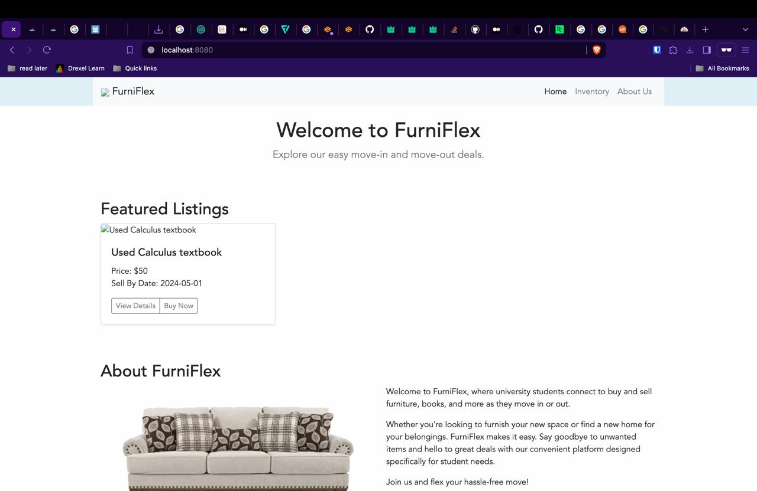
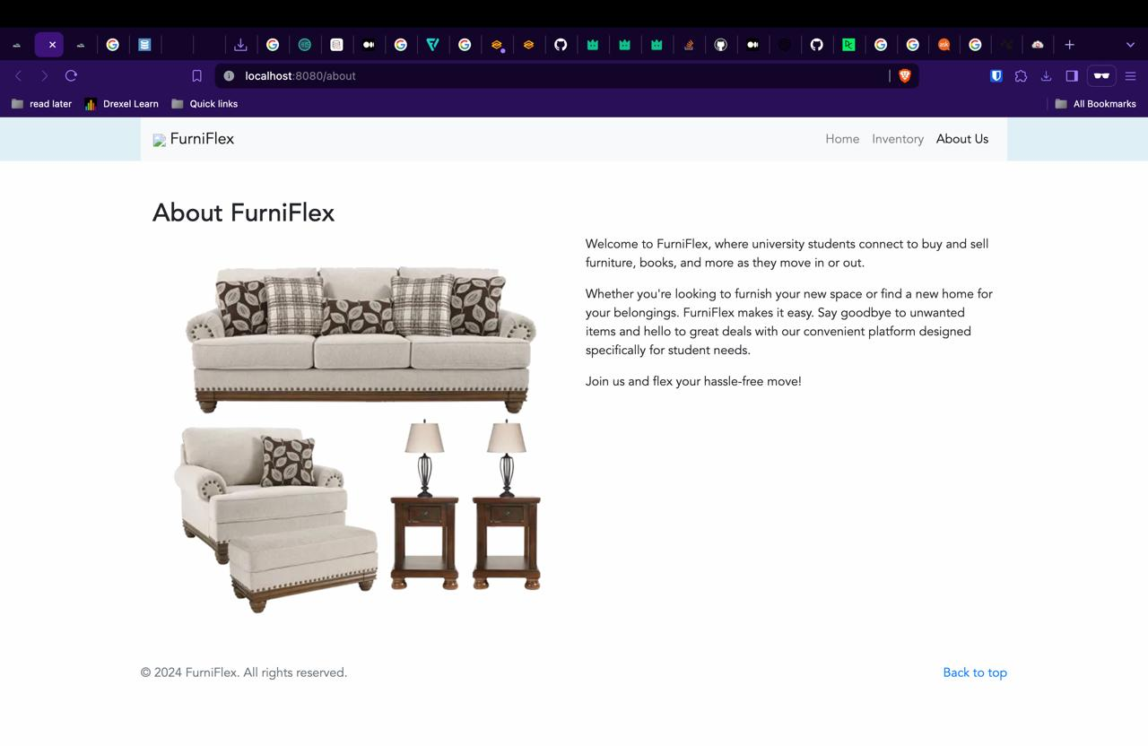
Implementation

Slide 6
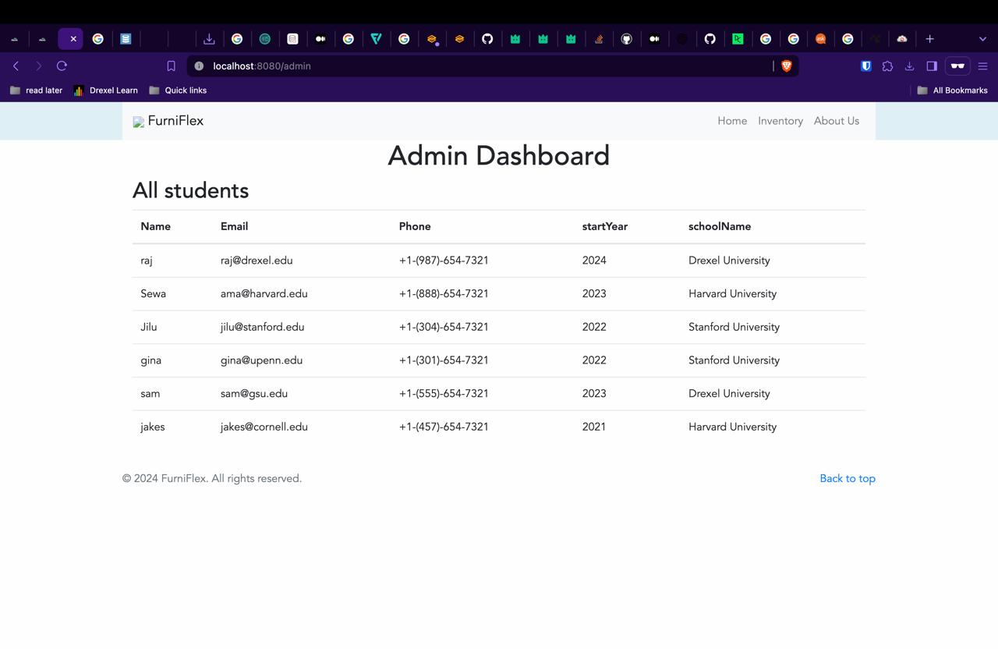
Implementation

Slide 7
Scope
IN-SCOPE
Development of a syatem for university students to buy and sell used/unused furniture and items.
User authentication through university email addresses to ensure a trusted community.
Listing and browsing functionality for items, including furniture such as chairs, tables, bed frames, etc.
Communication tools to facilitate interactions between buyers and sellers.
Implementing payment processing for transactions within the platform.
OUT-SCOPE
Providing delivery services for items sold through the platform.
Managing transactions outside of the platform.
Offering warranty or guarantee services for items sold.
Integration with external e-commerce platforms.
Expanding beyond the university student community to include non-student users.

Slide 8
Requirements
Student: studentEmail, name , phoneNumber, entryYear, schoolName, address
Account: accountID, username, password, graduationYear, paymentCardInformation
Listing: itemID, price, description, sellByDate, status
Transactions: transactionID
Message: messageID, encryptedContent

Slide 9
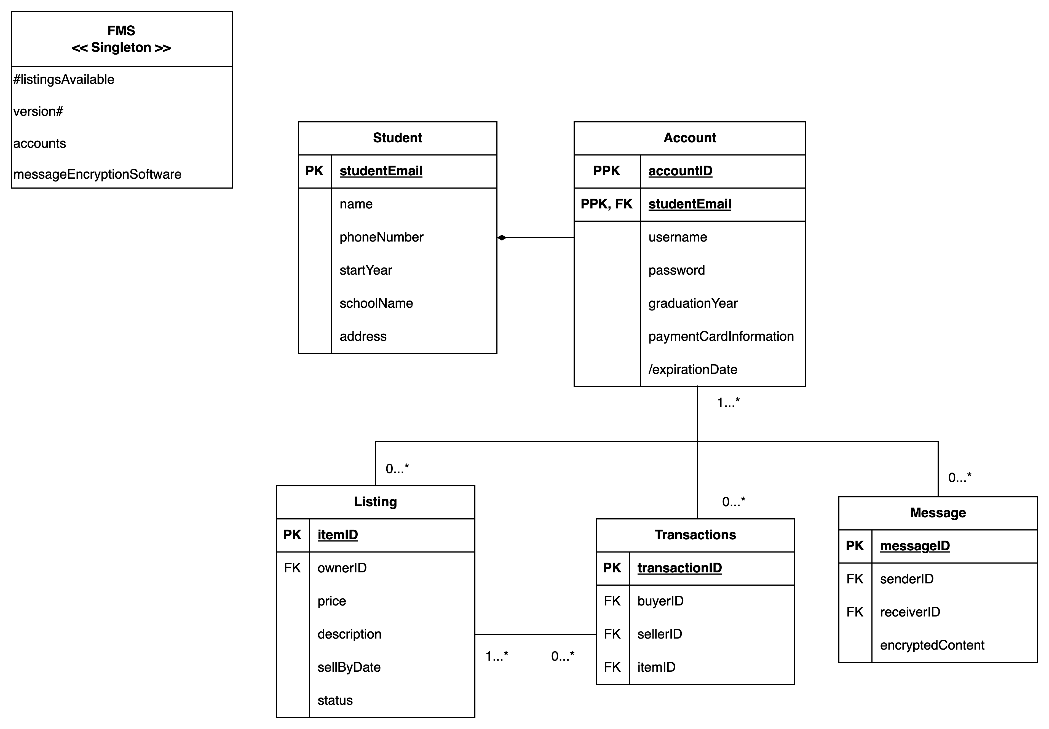
Simplified Logical ERD Design

Slide 10

Product benefits
Helps in slowing rates of global warming by encouraging recycling and reducing wastage
Reduces workload for government workers such as Disposal workers or cleaners etc
Easy to track users to avoid cat fishing or fraud

Slide 11
Competitive Landscape & Market Need
Platforms like Facebook Marketplace, Craigslist, and eBay offer general-purpose marketplaces for buying and selling used items, including furniture.
While these platforms provide broad access to a wide range of items, they lack the focused community and trust factor inherent in FurniFlex.
FurniFlex, unlike general platforms, caters specifically to university students, leveraging their shared community and trust in university email authentication.
By tailoring the experience to the unique needs of students, FurniFlex offers a more relevant and convenient solution for buying and selling furniture within the campus ecosystem.
FurniFlex provides a platform where students can find affordable furniture options within their community, addressing the challenges faced by students in getting reliable and economical furnishing solutions.

Slide 12
Comparison with Competitors
Facebook Marketplace:
Lack of focus on university communities, resulting in a broader and less targeted user base.
Limited trust and verification mechanisms, leading to potential safety concerns for transactions between strangers.
Craigslist:
Anonymity of users may lead to security risks and scams, as there is no built-in verification process.
Limited search and filtering options, making it challenging to narrow down results to specific university communities or preferences.
eBay:
Higher fees for sellers, including listing fees and transaction fees, which may discourage casual sellers or students on a budget.
Longer shipping times and potential shipping costs for larger furniture items, making it less suitable for local transactions within university communities.
Competing with a wide range of sellers and products from across the globe, resulting in less localized and community-focused experience.

Slide 13
FurniFlex Competitive Advantage
Combats Inflation
Encourages sustainability
Reduces workload for essential workers
Helps save
Recycling Friendly
Less chances for Fraud
Only product specifically dedicated to this niche market
Well-designed product that's both stylish and functional
Conducted testing with college students in the area
Designed with the help and input of experts in the field

Slide 14
Projected Sustainability - FurniFlex's Environmental Impact
Recycling: FurniFlex promotes sustainability by facilitating the reuse and recycling of furniture items within university communities, reducing the need for new production and minimizing waste.
Emission Reduction: By encouraging local transactions, FurniFlex reduces transportation emissions associated with the delivery of new furniture items, contributing to a greener environment.
Landfill Diversion: By extending the lifespan of furniture through resale and reuse, FurniFlex helps divert furniture from landfills, mitigating the environmental impact of disposal and landfill accumulation.
Community Engagement: FurniFlex fosters a culture of environmental responsibility and conscious consumption within university communities, empowering students to make eco-friendly choices in their furnishing decisions.

Slide 15
For Chubb
Our model can be used to to decrease customer churn rate while increasing accessibility to children and the elderly

Slide 16

Future Scalability & Growth Strategy
Explore opportunities to partner with more universities and expand the platform's reach to additional campuses.
Continuously innovate by adding new features like user ratings, personalized recommendations, and virtual staging.
Develop a mobile app to increase accessibility and cater to the preferences of the mobile-first generation.
Promote a vibrant community through events, forums, and social media campaigns to increase user engagement and retention.
Introduce premium features, advertising opportunities, or transaction fees to generate revenue while keeping basic services free for users.
Consider international expansion to universities worldwide, tapping into a broader market of students seeking affordable furnishing solutions.
Include visuals representing growth, expansion, innovation, and community engagement, along with a world map indicating potential global expansion.

Slide 17
References
https://www.businessnewsdaily.com/9481-p2p-marketplace-apps.html
https://globalnews.ca/news/8740368/facebook-marketplace-users-pros-cons-scam/
https://www.zipsale.co.uk/blog/ebay-vs-facebook-marketplace

Slide 18

Thank you

